Slide 1
चरैवेति, चरैवेति
Keep progressing to attain a higher self.
avinash.bhagat@lpu.co.in Avinash Bhagat 9463281930

Slide 2
CAP275: Data Communication and Networking
Lecture 6-8
OSI Model
avinash.bhagat@lpu.co.in Avinash Bhagat 9463281930

Slide 3
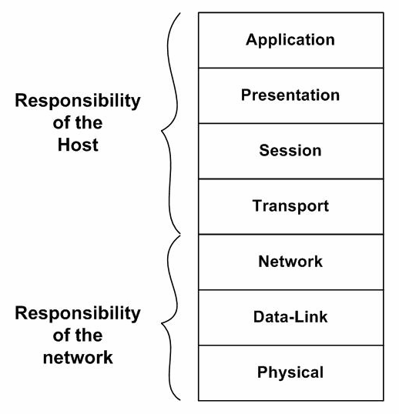
ISO’s
Open System Interconnection Architecture

Slide 4
ISO’s
Open System Interconnection Architecture
S/ W or H/W
S/W
S/W
S/W
S/W
S/W and H/W
S/W and H/W
H/W

Slide 5
ISO’s
Open System Interconnection Architecture
Devices
Gateway and firewalls operate on all the layers
Router
Layer-2 Switches , NIC &Bridge
hubs, repeaters & Ethernet cable connectors.

Slide 6
ISO’s
Open System Interconnection Architecture
PDU Protocol Data Unit
Data
Data
Data
Segment
Packet
Frame
Bits and Bytes

Slide 7
ISO’s
Open System Interconnection Architecture
Type of addresses
Specific
Port 16 bits
Logical 32 bits
Physical /link 48 bits

Slide 8
ISO’s
Open System Interconnection Architecture
Flow of Data
Process to process
End to End
Hop to Hop or node to node

Slide 9
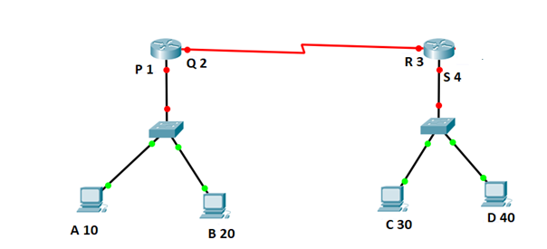
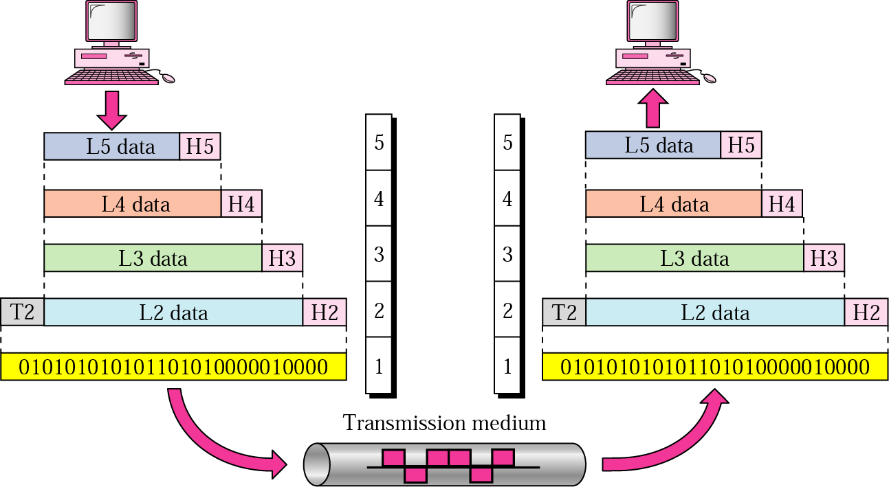

Slide 10









Protocol Data Unit
PDU
Data
Segment
Packet
Frame
PDU Bits and Bytes
010 101011100011010

Slide 12
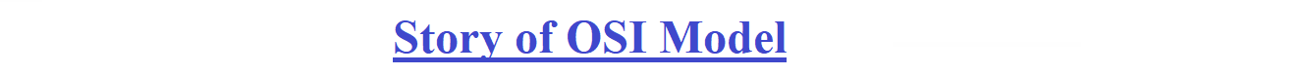


Slide 13
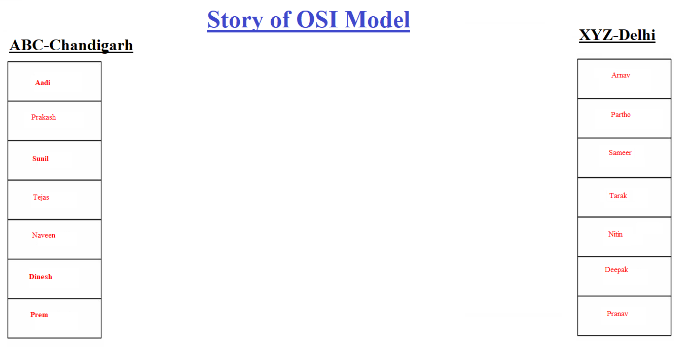


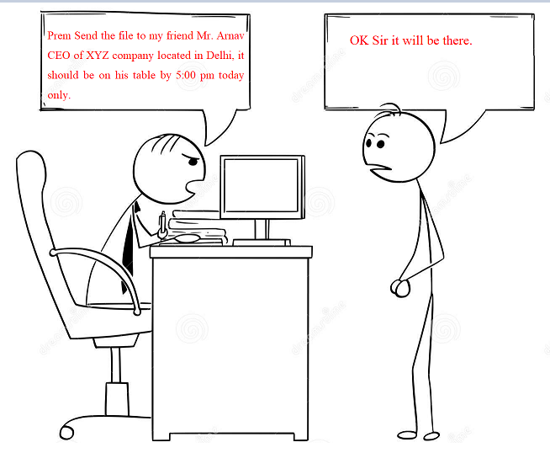

Slide 14


Slide 15
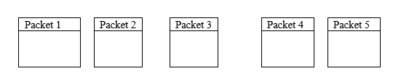

Slide 16
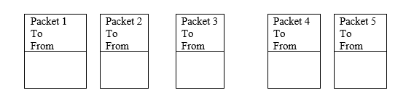

Slide 17
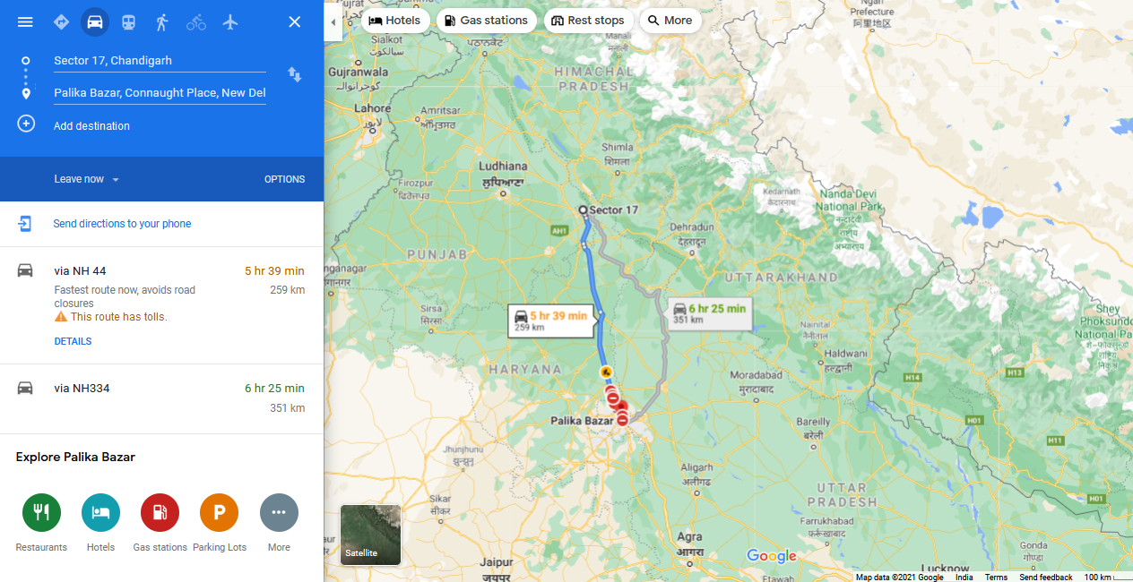

Slide 18


Slide 19


Slide 20



Slide 21


Slide 22

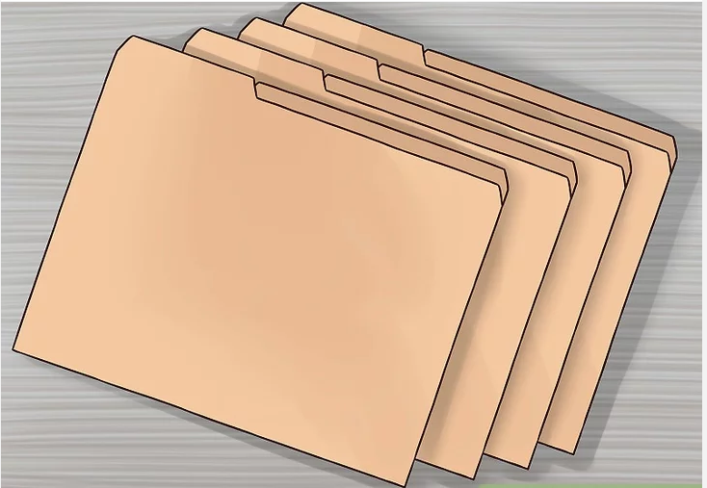

Slide 25
Physical Layer
Concerned with transmission of raw bits over a communication channel.
Number of pins and functions of each pin of the network connector.
Signal level, data rate (electrical)
Direction of data transmissions
Establishing or breaking connection
Deals with physical transmission medium.

Slide 26
Physical Layer
Physical characteristics of interface and medium.
Representation of bits.
Data rate and duration of bits.
Synchronization of sender and receiver clock.
Line configuration—point to point or multipoint.
Physical topology
Transmission mode.– simplex or duplex

Slide 27
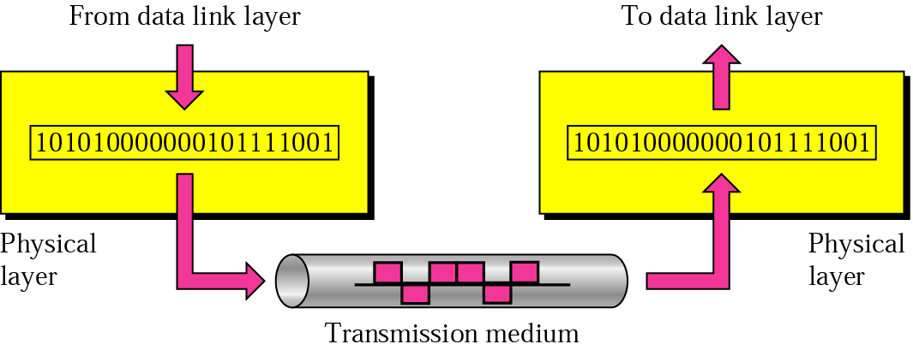
Figure 2.5 Physical layer

Slide 28
Data link Layer
This layer transforms the physical layer to a reliable transmission/ reception of structures stream of data. Functions of data link layer are:
  Framing: manageable data units are called frames
  Physical addressing: data link layer adds a header to the frame to define sender or receiver of the frame.

Slide 29
Data link Layer
Flow control:
Error control
Access control.

Slide 30
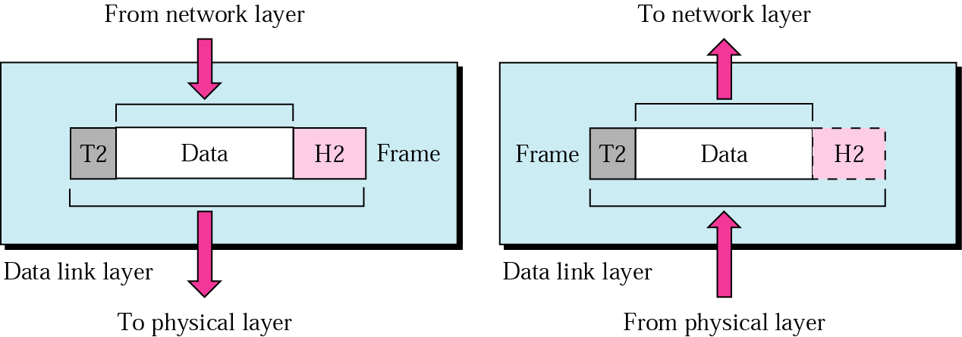
Figure 2.6 Data link layer

Slide 31
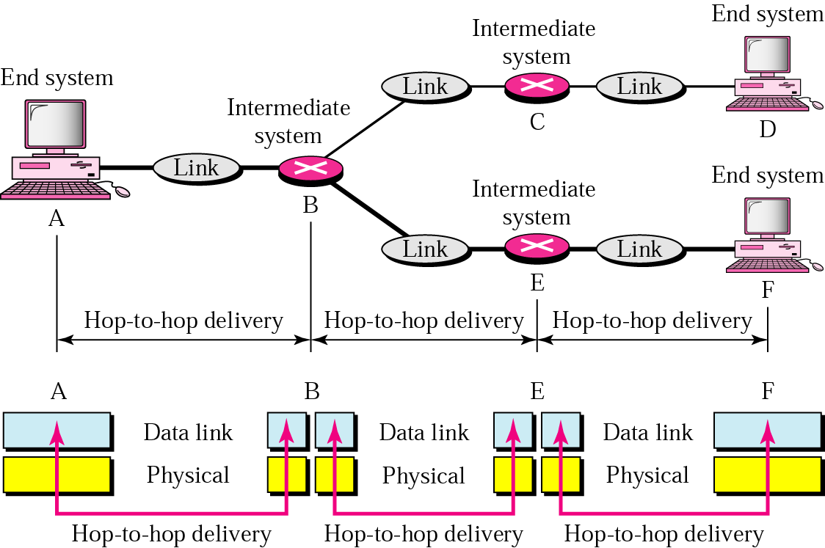
Figure 2.7 Node-to-node delivery

Slide 32
Example 1
In Figure 2.8 a node with physical address 10 sends a frame to a node with physical address 87. The two nodes are connected by a link. At the data link level this frame contains physical addresses in the header. These are the only addresses needed. The rest of the header contains other information needed at this level. The trailer usually contains extra bits needed for error detection

Slide 33
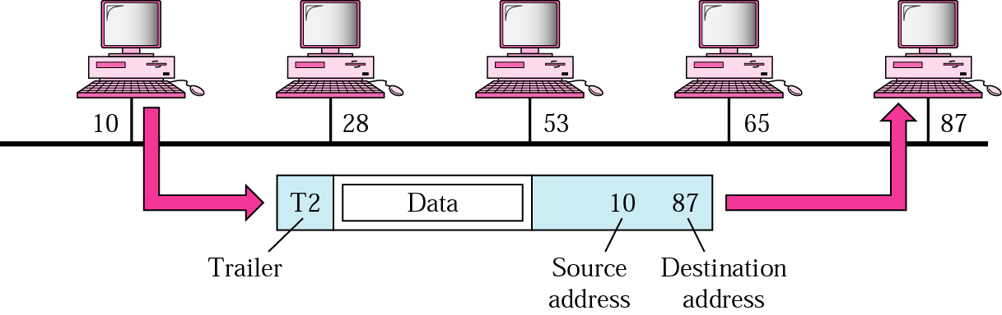
Figure 2.8 Example 1

Slide 34
Network Layer
This layer is responsible for source to destination delivery of a packet possibly across multiple networks by establishing, maintaining and terminating connections.
Data link layer sees the delivery of packets between two system on the same network (links).

Slide 35
Network Layer
Functions of network layer:
Logical addressing : if a packet passes the network boundary, we need another addressing system to help distinguish the source and destination system
Routing
Assembly disassembly of messages
Message priorities
internetworking

Slide 36
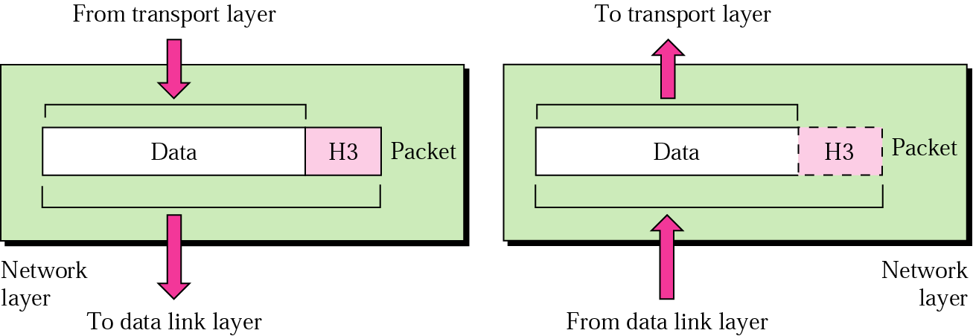
Figure 2.9 Network layer

Slide 37

Note:
The network layer is responsible for the delivery of packets from the original source to the
final destination.

Slide 38
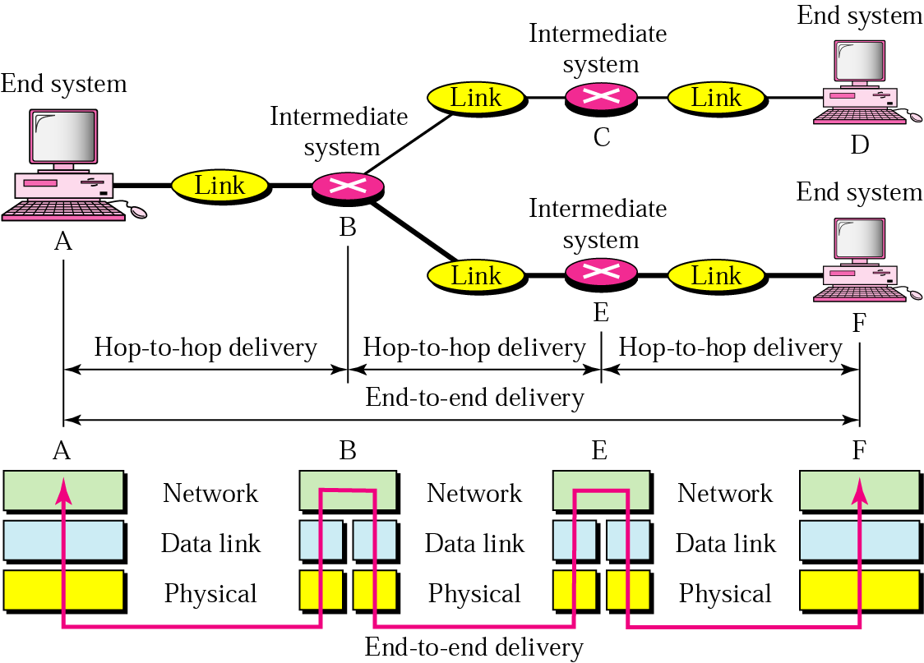
Figure 2.10 Source-to-destination delivery

Slide 39
Example 2
In Figure 2.11 we want to send data from a node with network address A and physical address 10, located on one LAN, to a node with a network address P and physical address 95, located on another LAN. Because the two devices are located on different networks, we cannot use physical addresses only; the physical addresses only have local jurisdiction. What we need here are universal addresses that can pass through the LAN boundaries. The network (logical) addresses have this characteristic.

Slide 40
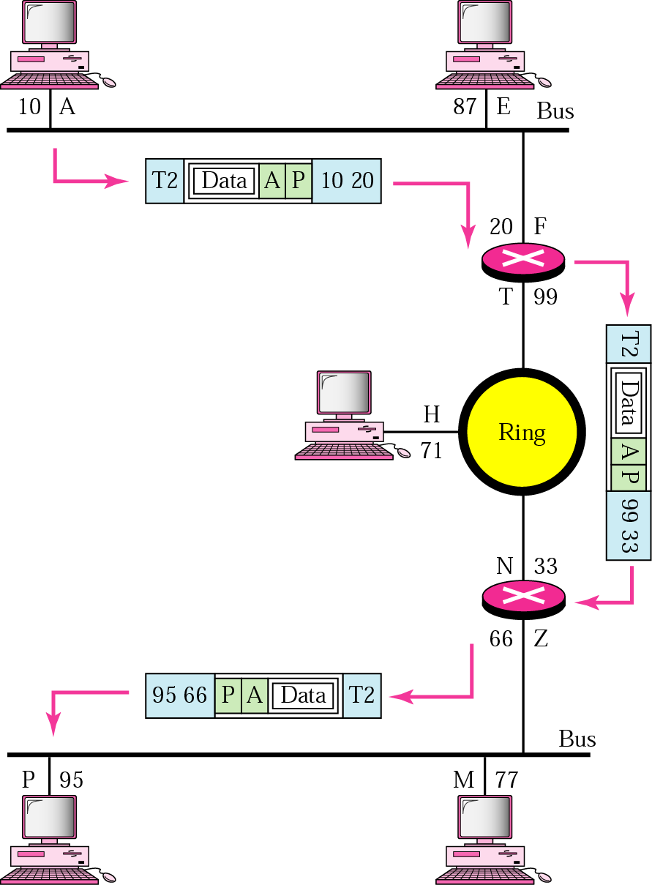
Figure 2.11 Example 2

Slide 41
Transport Layer
Transport layer is responsible for Process to process communication. Functions of transport layer:
It monitors quality of Service
Port addressing
Segmentation and reassembly
Connection control
Flow control
Error control i.e. End to end error detection.
Multiplexing

Slide 42
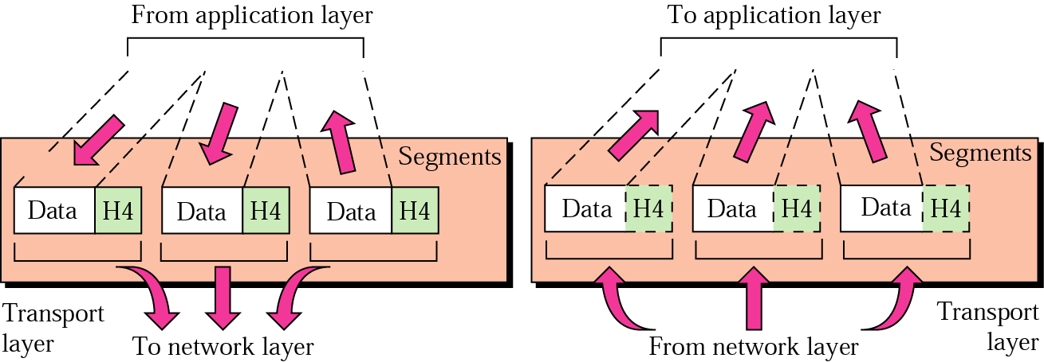
Figure 2.12 Transport layer

Slide 43
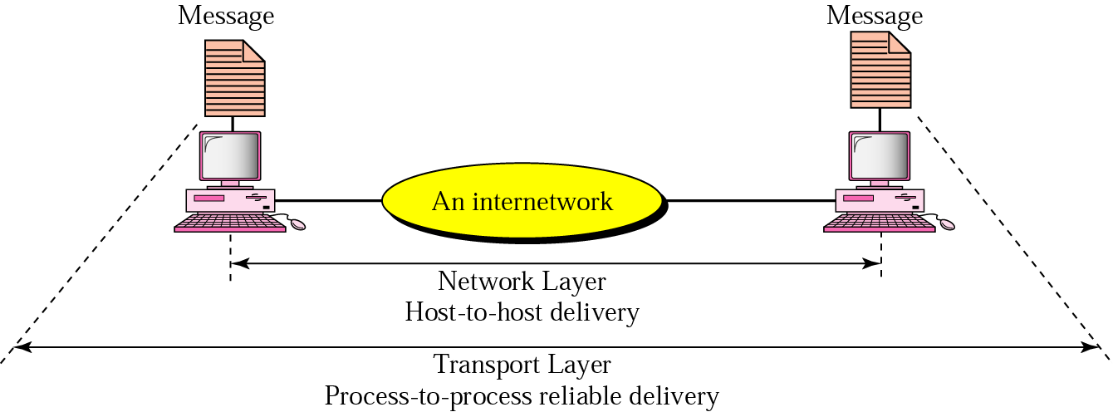
Figure 2.12 Reliable process-to-process delivery of a message

Slide 44
Example 3
Figure 2.14 shows an example of transport layer communication. Data coming from the upper layers have port addresses j and k (j is the address of the sending process, and k is the address of the receiving process). Since the data size is larger than the network layer can handle, the data are split into two packets, each packet retaining the port addresses (j and k). Then in the network layer, network addresses (A and P) are added to each packet.

Slide 45
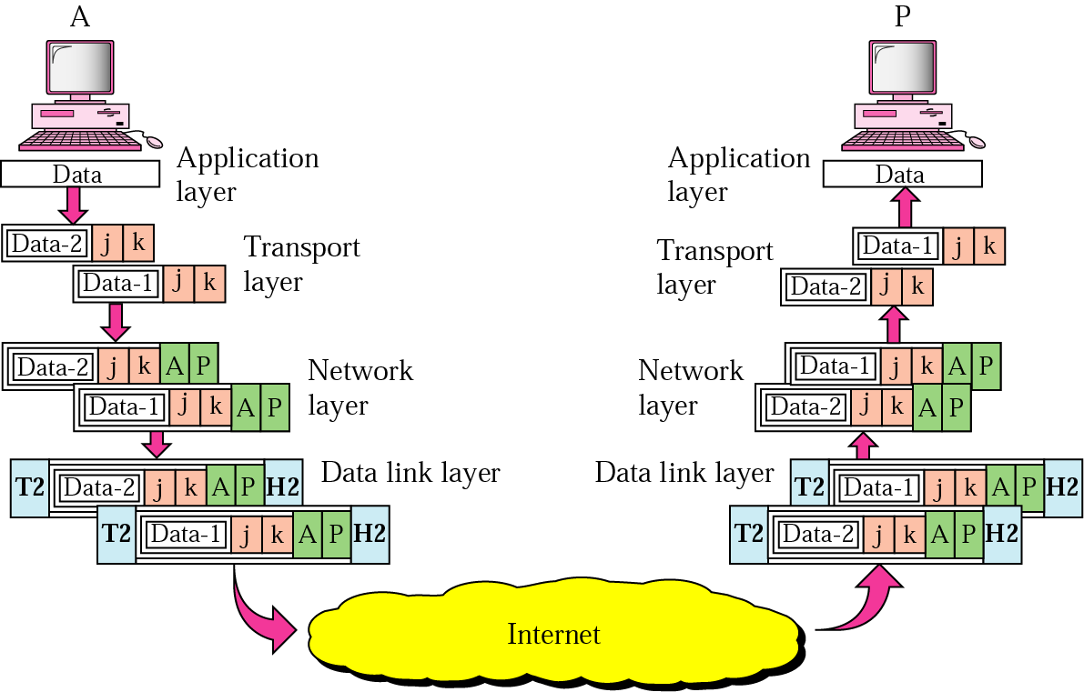
Figure 2.14 Example 3

Slide 46
Session Layer
Establishes connection and termination
Performs dialog management:
  Who speaks, when, how long
  Simplex
  Half duplex
  Full duplex
Recovery from failure by using check polling
Token management.

Slide 47
Presentation Layer
Functions of Presentation layer:
Syntax and semantics of information
Data types
Character code
Data compression / decompression
Encryption and decryption

Slide 48
Application Layer
Concerned with user application
Common application service element
CASE login, password checks
Specific Application Service Element
  file transfer, access and management
  Job transfer and manipulation
  Electronic mail
  Videotex, telefax etc
  Message handling.
  Document transfer.

Slide 49
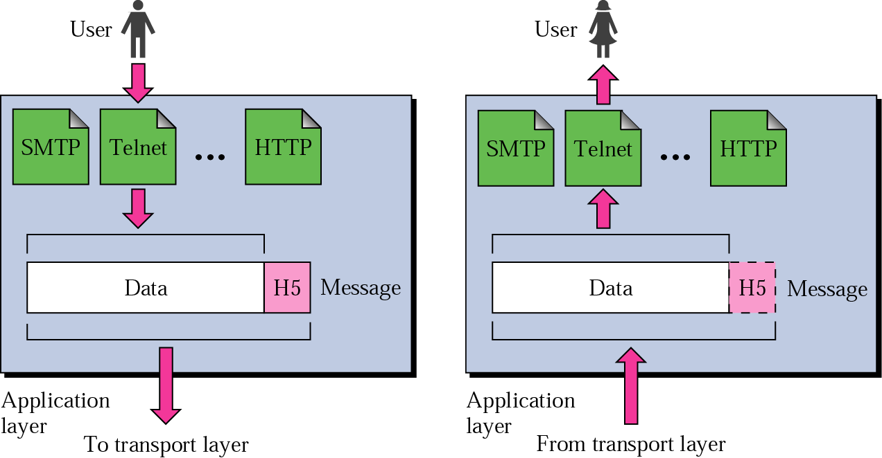
Figure 2.15 Application layer

Slide 50
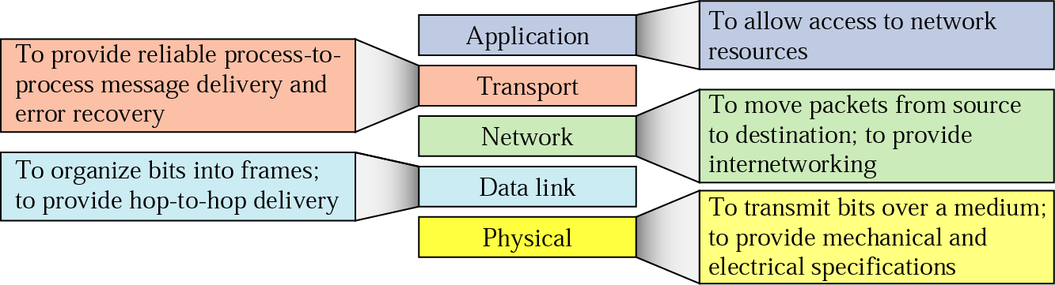
Figure 2.16 Summary of duties

Slide 51
Subjective Questions
What are the key functions of a physical layer?

Slide 52
Multiple Choice Questions
The process-to-process delivery of the entire message is the responsibility of the _______ layer.
a. Network
b. Transport
c. Application
d. Physical
Mail services are available to network users through the _______ layer.
a. Data link
b. Physical
c. Transport
d. Application
When data are transmitted from device A to device B, the header from A's layer 4 is read by B's _______ layer.
a. Physical
b. Transport
c. Application
d. None of the above

Slide 53
Multiple Choice Questions
The process-to-process delivery of the entire message is the responsibility of the _______ layer.
a. Network
b. Transport
c. Application
d. Physical
Mail services are available to network users through the _______ layer.
a. Data link
b. Physical
c. Transport
d. Application
When data are transmitted from device A to device B, the header from A's layer 4 is read by B's _______ layer.
a. Physical
b. Transport
c. Application
d. None of the above

Slide 54
Multiple Choice Questions
The _______ layer changes bits into electromagnetic signals.
a. Physical
b. Data link
c. Transport
d. None of the above
Which of the following is an application layer service?
a. Remote log-in
b. File transfer and access
c. Mail service
d. All the above
Why was the OSI model developed?
a. Manufacturers disliked the TCP/IP protocol suite.
b. The rate of data transfer was increasing exponentially
c. Standards were needed to allow any two systems to communicate
d. None of the above

Slide 55
Multiple Choice Questions
The _______ layer changes bits into electromagnetic signals.
a. Physical
b. Data link
c. Transport
d. None of the above
Which of the following is an application layer service?
a. Remote log-in
b. File transfer and access
c. Mail service
d. All the above
Why was the OSI model developed?
a. Manufacturers disliked the TCP/IP protocol suite.
b. The rate of data transfer was increasing exponentially
c. Standards were needed to allow any two systems to communicate
d. None of the above

Slide 56
Multiple Choice Questions
The _______ model shows how the network functions of a computer ought to be organized.
a. CCITT
b. OSI
c. ISO
d. ANSI
The physical layer is concerned with the movement of _______ over the physical medium.
a. programs
b. dialogs
c. protocols
d. bits

Slide 57
Multiple Choice Questions
The _______ model shows how the network functions of a computer ought to be organized.
a. CCITT
b. OSI
c. ISO
d. ANSI
The physical layer is concerned with the movement of _______ over the physical medium.
a. programs
b. dialogs
c. protocols
d. bits

Slide 58
Multiple Choice Questions
In the OSI model, what is the main function of the transport layer?
a. node-to-node delivery
b. process-to-process message delivery
c. synchronization
d. updating and maintenance of routing tables
In the OSI model, encryption and decryption are functions of the ________ layer.
a. transport
b. session
c. presentation
d. application
When a host on network A sends a message to a host on network B, which address does the router look at?
a. port
b. logical
c. physical
d. none of the above

Slide 59
Multiple Choice Questions
In the OSI model, what is the main function of the transport layer?
a. node-to-node delivery
b. process-to-process message delivery
c. synchronization
d. updating and maintenance of routing tables
In the OSI model, encryption and decryption are functions of the ________ layer.
a. transport
b. session
c. presentation
d. application
When a host on network A sends a message to a host on network B, which address does the router look at?
a. port
b. logical
c. physical
d. none of the above

Slide 60
Multiple Choice Questions
To deliver a message to the correct application program running on a host, the _______ address must be consulted.
a. port
b. IP
c. physical
d. none of the above
IPv6 has _______ -bit addresses.
a. 32
b. 64
c. 128
d. variable

Slide 61
Multiple Choice Questions
To deliver a message to the correct application program running on a host, the _______ address must be consulted.
a. port
b. IP
c. physical
d. none of the above
IPv6 has _______ -bit addresses.
a. 32
b. 64
c. 128
d. variable

Slide 62
Multiple Choice Questions
The ______ layer is responsible for moving frames from one hop (node) to the next.
a. physical
b. data link
c. transport
d. none of the above
The ______ layer adds a header to the packet coming from the upper layer that includes the logical addresses of the sender and receiver.
a. physical
b. data link
c. network
d. none of the above

Slide 63
Multiple Choice Questions
The ______ layer is responsible for moving frames from one hop (node) to the next.
a. physical
b. data link
c. transport
d. none of the above
The ______ layer adds a header to the packet coming from the upper layer that includes the logical addresses of the sender and receiver.
a. physical
b. data link
c. network
d. none of the above

Slide 64
Multiple Choice Questions
The_________ layer is responsible for the delivery of a message from one process to another.
a. physical
b. transport
c. network
d. none of the above
The ________ address, also known as the link address, is the address of a node as defined by its LAN or WAN.
a. port
b. physical
c. logical
d. none of the above

Slide 65
Multiple Choice Questions
The_________ layer is responsible for the delivery of a message from one process to another.
a. physical
b. transport
c. network
d. none of the above
The ________ address, also known as the link address, is the address of a node as defined by its LAN or WAN.
a. port
b. physical
c. logical
d. none of the above

Slide 66
MCQ
________ defines how a particular pattern to be interpreted, and what action is to be taken based on that interpretation.
a. Semantics
b. Syntax
c. Timing
d. None of the above
Notes:
Timing.
For example, if a sender produces data at 100 Mbps but the receiver can process data at only 1 Mbps, the transmission will overload the receiver and some data will be lost.

Slide 67
MCQ
_______ refers to two characteristics: when data should be sent and how fast it can be sent.
a. Semantics
b. Syntax
c. Timing
d. none of the above
Notes:
Timing.
For example, if a sender produces data at 100 Mbps but the receiver can process data at only 1 Mbps, the transmission will overload the receiver and some data will be lost.

Slide 68
Subjective Questions
Q1 What are various components of a data communication model? Explain all the components in detail. [5 marks]
Q2 What is a protocol? What are its components? [5 marks]
Q3 Define protocol and its components. What functions can a protocol performs?
Notes:
Timing.
For example, if a sender produces data at 100 Mbps but the receiver can process data at only 1 Mbps, the transmission will overload the receiver and some data will be lost.

Slide 69


See you in next class

